Slide 1
#2 USING FINANCIAL STATEMENTS AND BUDGETS

Slide 2
Learning Goals
Understand the relationship between financial plans and statements.
Prepare a personal balance sheet
Generate a personal income and expense statement.
Develop a good record-keeping system and use ratios to evaluate personal financial statements.
Construct a cash budget and use it to monitor and control spending.
Apply time vale of money concepts to put a monetary value on financial goals.

Slide 3
Mapping Out Your Financial Future
Financial planning facilitates:
Greater Wealth
Financial Security
Attainment of Financial Goals

Slide 4
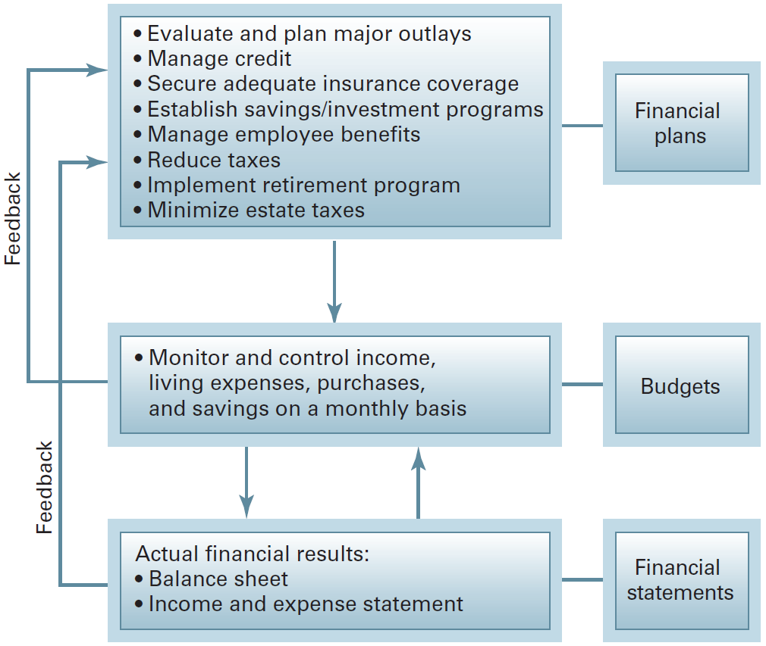
The Interlocking Network of Financial Plans and Statements

Slide 5
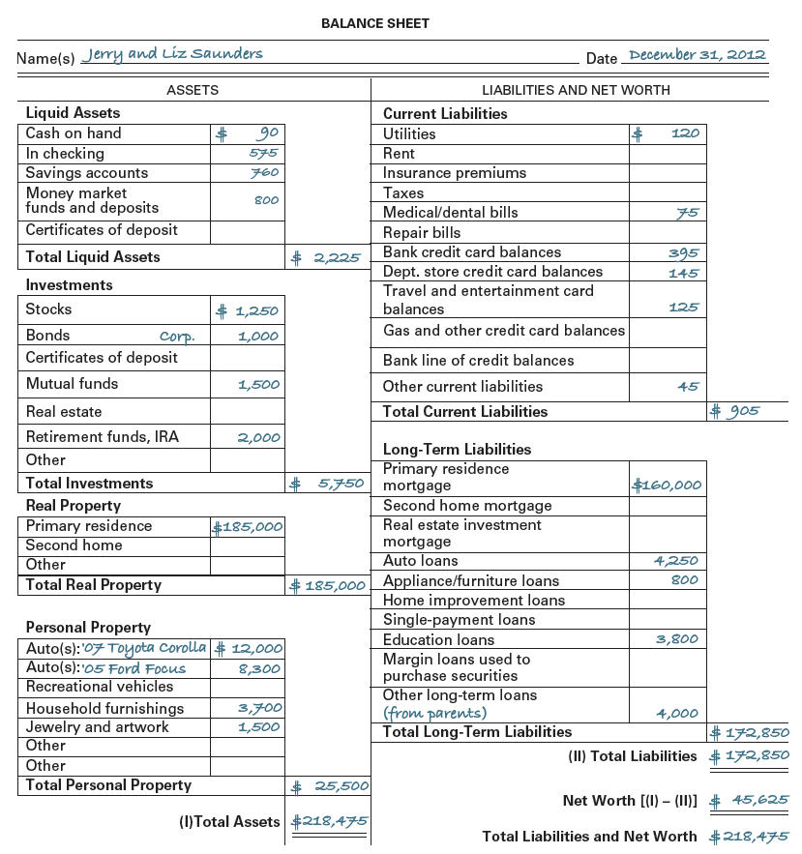
Balance Sheet
A statement of your financial position at a given point in time

Slide 6

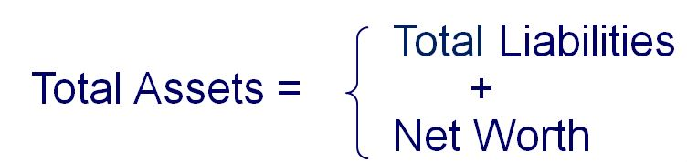
Balance Sheet Equation

Slide 7
Assets: Things You Own
Liquid assets – low-risk, cash or investments that can be converted to cash quickly with little or no loss in value
Investments – acquired to earn a return
Real property – immovable property including land or a house
Personal Property – movable property such as autos and home furnishings

Slide 8
Liabilities: Money You Owe
Classification by Maturity
Current or short-term — due within a year such as utility or repair bills
Long-term — due in a year or more including mortgages, education and consumer installment loans

Slide 9
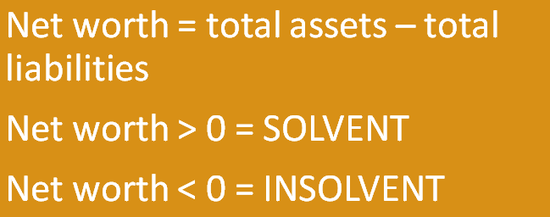
Net Worth: Measure of Your Financial Worth
Actual wealth or equity that individuals have in owned assets

Slide 10
Median Net Worth by Age

Slide 11
The Income and Expense Statement
A measure of financial performance over a given time period
income (cash in)
expenses (cash out)
cash surplus (or deficit)

Slide 12
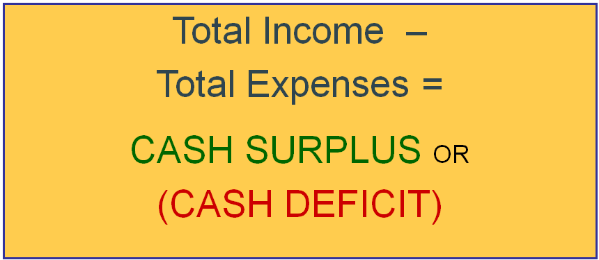
Income and Expense Statement

Slide 13
Income: Cash In
Wages and salaries
Bonuses and commissions
Interest and dividends
Child support
Tax refunds
Gifts

Slide 14
Expenses: Cash Out
Living Expenses — Housing, utilities, food, insurance
Tax Payments —Federal, state, local
Asset Purchases — Autos, furniture, appliances
Other Payments —Personal care, recreation, entertainment

Slide 15
Expenses: Cash Out (continued)
Fixed
Contractual, equal payments fixed
rent or mortgage, insurance, cable TV payments
Variable
Amounts change from one period to the next
credit card payments

Slide 16
Preparing the Income and Expense Statements
Record your income from all sources for the chosen period.
Establish meaningful expense categories.
Subtract total expenses from total income to get cash surplus or deficit.

Slide 17
How We Spend Our Income

Slide 18

Using Your Personal Financial Statements
Keeping good records
Organize records
Tracking financial progress – Ratio Analysis
Balance Sheet Ratios
Income and Expense Statement Ratios

Slide 19

Balance Sheet Ratios
Solvency Ratio
Net worth at a given point in time
Indicates potential to withstand financial problems

Slide 20

Liquidity Ratios
Measures ability to pay current debts with existing liquid assets
“Current” = payment within one year

Slide 21

Income & Expense Statement Ratios
Savings Ratio
Shows percentage of after-tax income saved during a time period

Slide 22

Debt Service Ratio
Indicates ability to repay loan obligations promptly with before-tax income

Slide 23
Preparing & Using Budgets
Budget
Short-term financial planning report that helps you achieve short-term financial goals
Achieving short-term goals helps you achieve longer-term goals

Slide 24
Using Budgets
Monitor and control finances
Allocate income to reach goals
Implement disciplined spending
Reduce needless spending
Achieve long-term financial goals

Slide 25
The Budgeting Process
Estimating Income
Estimating Expenses
Finalize the Cash Budget

Slide 26

Dealing with Deficits
Shift expenses from months with deficits to months with surpluses
Use savings, investments, or borrowing to cover temporary deficits

Slide 27
If You End the Year in a Deficit
Liquidate savings/investments
Borrow to cover the deficit
Cut low priority expenses; alter spending habits
Increase income

Slide 28
Using Your Budgets
Budget Control Schedule compares actual figures with various budget categories and shows variances
Continually update your budget based upon the actual figures.

Slide 29

Time Value of Money
Putting a Dollar Value on Financial Goals
A dollar today is worth more than a dollar received in the future because it can be invested and earn interest.

Slide 30
Types of TVM Calculations
Single sum — one lump sum investment with no additions or subtractions
Annuity — series of equal payments made at fixed time intervals for a specified number of periods

Slide 31
Future Value
Value invested money will grow to become earning a specific rate of interest over a given time period
Process of growing today’s present value to a larger future value by applying compound interest known as “compounding.”

Slide 32

Calculating the Future Value of a Single Sum
Example:
What will $5,000 grow to become if invested at 5% for 6 years?

Slide 33
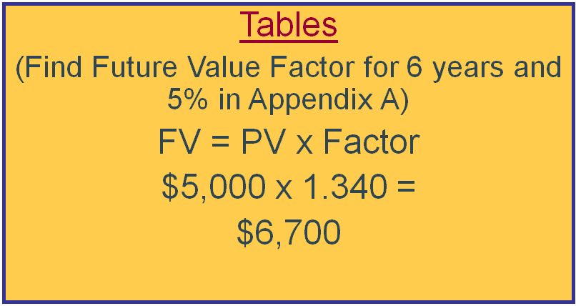
Calculating the Future Value of a Single Sum (continued)

Slide 34
Calculating the Future Value of an Annuity
Example:
What would you accumulate if you could invest $5,630.70 every year for the next 6 years at 5%?

Slide 35
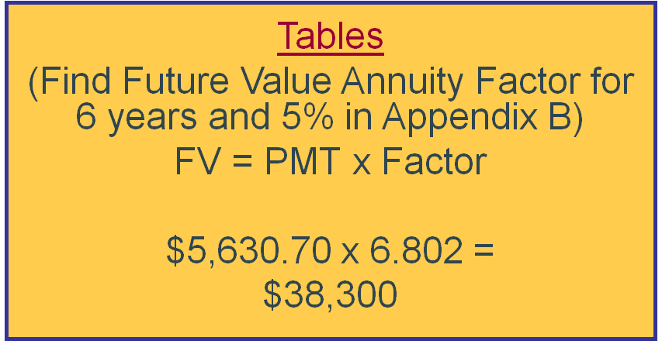
Calculating the Future Value of an Annuity (continued)

Slide 36
Present Value
Amount needed today to invest at a specific rate of interest over a given time period to accumulate a desired future amount
“Discounting” is the reverse of compounding - process of working from the future value back to present value

Slide 37
Calculating the Present Value of a Single Sum
Example:
You wish to accumulate a retirement fund of $300,000 in 25 years. If you can invest at 5%, what single lump-sum deposit must you make today in order to achieve your goal?

Slide 38
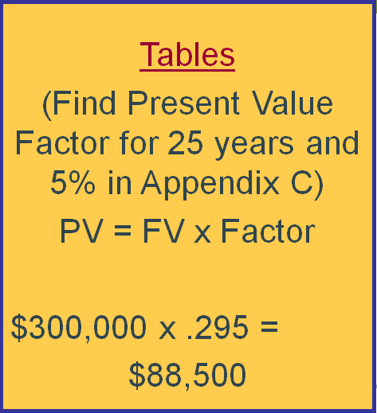
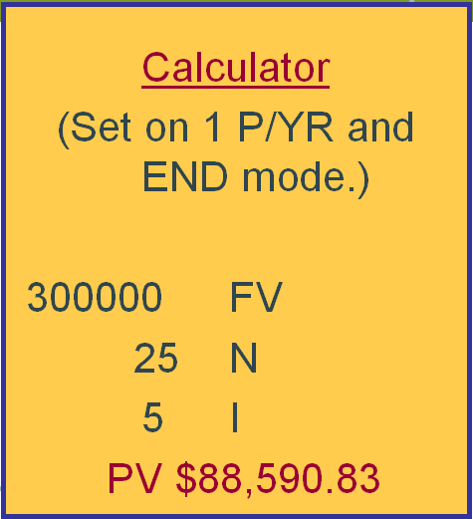
Calculating the Present Value of a Single Sum (continued)

Slide 39
Calculating the Present Value of an Annuity
Example:
You have a $300,000 retirement fund and wish to take out equal annual withdrawals over the next 30 years. How much can you withdraw if interest rates are 5% on the investment?

Slide 40
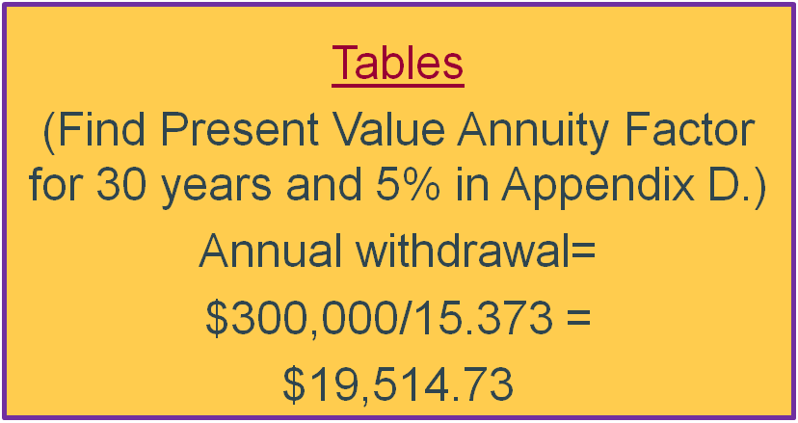
Calculating the Present Value of an Annuity (continued)

